Slide 1
CIS590-SP19 - Practical Research Project
Image Classifier using Haarcascade(a machine learning technology).
Presented by
Tushar Jangade.
Under the guidance of
Dr. Bahareh Rahmani.

Slide 2
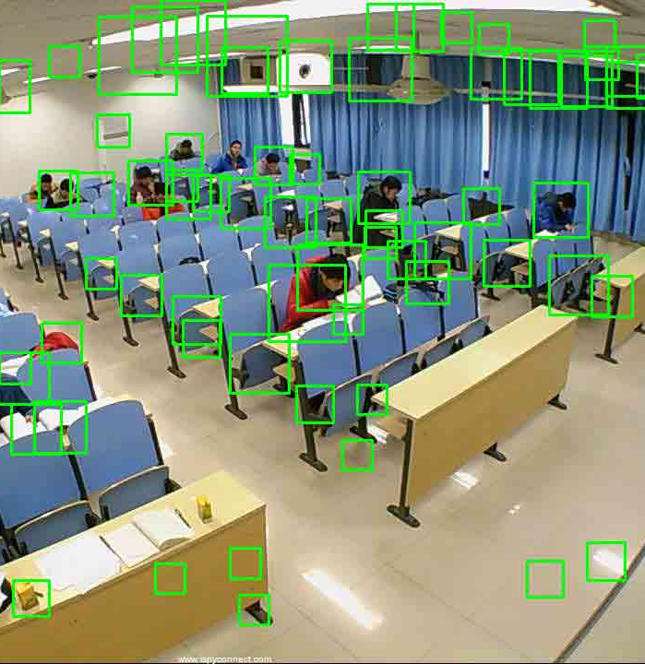
Abstract.
Object Detection using Haar Cascade Classifier widely applied in several devices and applications as a medium of interaction between human and computer such as a tool control that utilizes the detection of Objects. Its identifies the object on the basis of the images for which it is trained for.

Slide 3
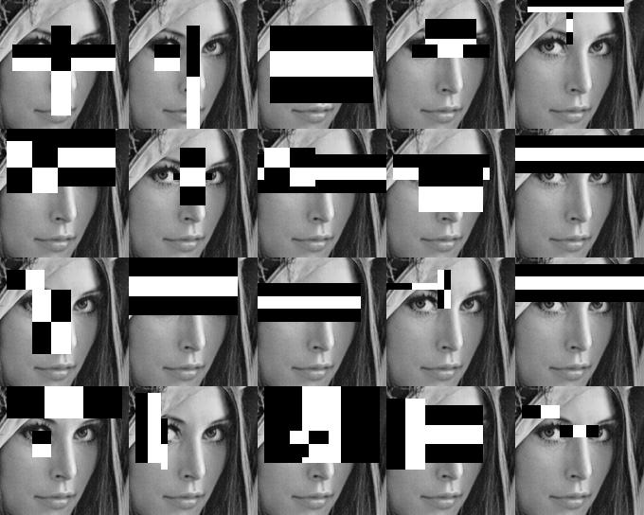
Introduction
What are cascade classifiers?
Classifiers are like black boxes that classify objects into various classes on the basis of a training set.
Let's understand the word cascade. Cascading means to form a chain, where the output of one stage is passed on to the next stage, and so on.

Slide 4
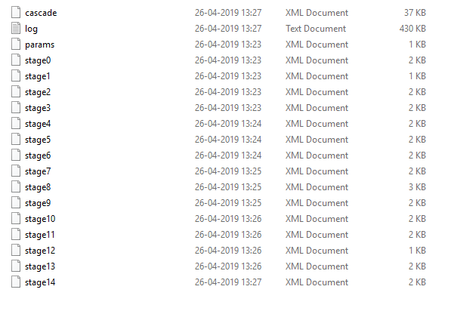
After making Cascade.

Slide 5

Motivation
Real life incident in Walmart with me.

Slide 6
Requirement specification.
Any operating system that will support OpenCV and Python (Windows, Linux, MacOS).
AWS Server (any server is okay).
Python.
OpenCV-Python.
Haar Cascades Data File.
i3 or higher core processor (CPU)/ 2.1 GHz or higher.
Positive and negative images (double the positive images then negative) for testing (thousands of them).

Slide 7
Steps.
Collect large number of negative images.
(images must not contain the image of the object which we are detecting.)
Collect large number of positive images.
(images having the picture of object which we want to detect. We need thousands of them)
Train our algorithm with this positive and negative images to make an .xml file.
Use the .xml file in your code to classify objects.

Slide 8
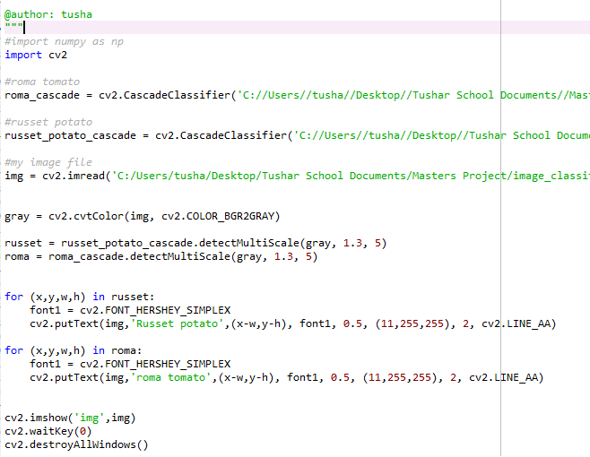
Code.

Slide 9
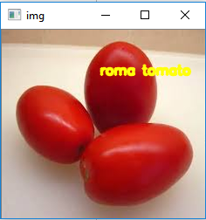
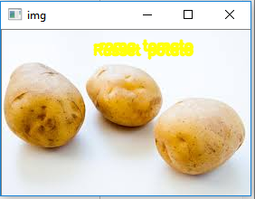
Outputs.

Slide 10
Solutions for better classification.
We can use TensorFlow as backend with keras framework. It is a part of deep learning.
Use of neural networks in TensorFlow.
Make our own images manually.
Get more and more positive images.

Slide 11
Future Work.
Rise of robots.
Stock market.
Increase security.
Empower businesses.
Improve healthcare.
Improve agriculture production.

Slide 12
References.
https://www.cs.auckland.ac.nz/~m.rezaei/Tutorials/Creating_a_Cascade_of_Haar-Like_Classifiers_Step_by_Step.pdf
https://us-east-2.console.aws.amazon.com/ec2/v2/home?region=us-east-2#Instances:sort=instanceState
https://www.youtube.com/watch?v=jG3bu0tjFbk
http://amin-ahmadi.com/cascade-trainer-gui/

Slide 13
Demo.

Slide 14
Thank you.

